Slide 1
Derivatives
邓光军
denggj@uestc.edu.cn
School of Management and Economics

Slide 2
Trading Strategies Involving Options
Option and the underlying asset
Two or more options of the same type
Mixture of calls & puts

Slide 3
Three Alternative Strategies
Take a position in the option and the underlying asset
Take a position in 2 or more options of the same type (A spread)
Combination: Take a position in a mixture of calls & puts (A combination)

Slide 4
Positions in an Option & the Underlying
S₀ - c
= Ke ^{–rT} +D - p
Profit
S₀ - c
≈ - p
K
S_{T}
Π = ( S_{T} – S₀ ) - max ( S_{T} - K, 0 ) + C₁

Slide 5
Positions in an Option & the Underlying
c -S₀
≈ p
Profit
K
S_{T}

Slide 6
Positions in an Option & the Underlying
p + S₀
≈ c
Profit
K
S_{T}

Slide 7
Positions in an Option & the Underlying
- S₀ - p
≈ - c
Profit
K
S_{T}

Slide 8
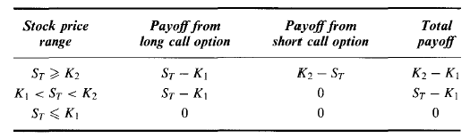

Bull Spread Using Calls
An investor who enters into a bull spread is hoping that the stock price will increase
Profit
S_{T}
K₁
K₂
П = max ( S_{T} - K₁ , 0 ) - C₁– max (S_{T} - K₂ , 0 ) + C₂

Slide 9

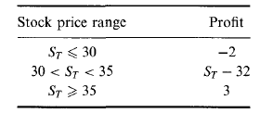
Bull Spread Using Calls
Profit
S_{T}
K₁
K₂

Slide 10
Bull Spread Using Puts
Profit
K₁
K₂
S_{T}

Slide 11
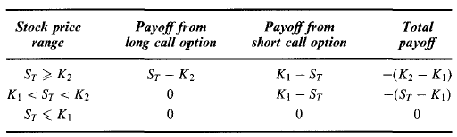
Bear Spread Using Calls
An investor who enters into a bear spread is hoping that the stock price will decline.
Profit
K₁
K₂
S_{T}

Slide 12

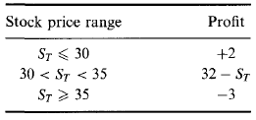
Bear Spread Using Calls
Profit
K₁
K₂
S_{T}

Slide 13
Bear Spread Using Puts
Profit
K₁
K₂
S_{T}

Slide 14
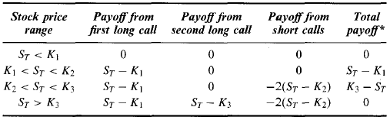
Butterfly Spread Using Calls
Profit
K₂=0.5*(K₁+K₃)
K₁
K₂
K₃
S_{T}
It is an appropriate strategy for an investor who feels that large stock price moves are unlikely.

Slide 15
Butterfly Spread Using Puts
Profit
K₁
K₂
K₃
S_{T}

Slide 16
Calendar Spread Using Calls
Profit
S_{T}
K

Slide 17
Calendar Spread Using Puts
Profit
S_{T}
K

Slide 18
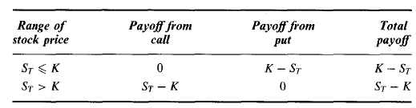
A Straddle（跨式） Combination
A straddle is appropriate when an investor is expecting a large move in a stock price but does not know in which direction the move will be
Profit
K
S_{T}

Slide 19
A Straddle Combination
自1994年下半年，利森参与的交易
买入日经225指数期货
卖出日本政府国债期货
从事日经225指数的跨式价差合约
1994年底，利森已经出售了35000个日经225指数的跨式价差合约
35000个看跌期权
35000个看涨期权
他们的到期日和执行价相同
执行价在18500和20000之间
Profit
Profit
S_{T}
K
S_{T}
K

Slide 20
A Straddle Combination
在1994年底，日经指数在19000~20000之间，在到期日之前如果保持这种状态，利森的跨式价差策略在到期日就能成功
Profit
S_{T}
K

Slide 21
A Straddle Combination
在1995年1月17日，日经指数位于19350点，但此时发生神户大地震，到周末日经指数跌至18950点。导致
看跌期权多头处于实值状态，引发了保证金催付，这些损失已超出了他出售看涨期权和看跌期权所得的期权费收入
神户地震发生后，交易员预期日经225未来波动率会更大，这又立即提升了看涨期权和看跌期权的价格。
利森所出售的看涨、看跌期权遭受了进一步的损失。
此时利森不得不通过以更高价格买入看涨、看跌期权来冲销他出售的跨式价差，因此造成了损失。

Slide 22
Strip
A strip consists of a long position in one call and two puts with the same strike price and expiration date
In a strip the investor is betting that there will be a big stock price move and considers a decrease in the stock price to be more likely than an increase
Profit
K
S_{T}

Slide 23
Strap
A strap consists of a long position in two calls and one put with the same strike price and expiration date
In a strap the investor is also betting that there will be a big stock price move. However, in this case, an increase in the stock price is considered to be more likely than a decrease
Profit
K
S_{T}

Slide 24
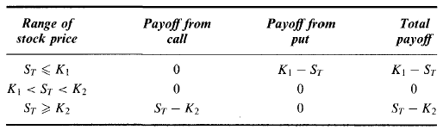
A Strangle （勒式）Combination
A strangle is a similar strategy to a straddle. The investor is betting that there will be a large price move, but is uncertain whether it will be an increase or a decrease
Profit
K₁
K₂
S_{T}

Slide 25
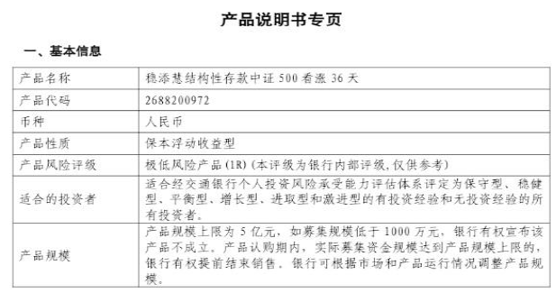
银行理财产品
中证500看涨36天

Slide 26
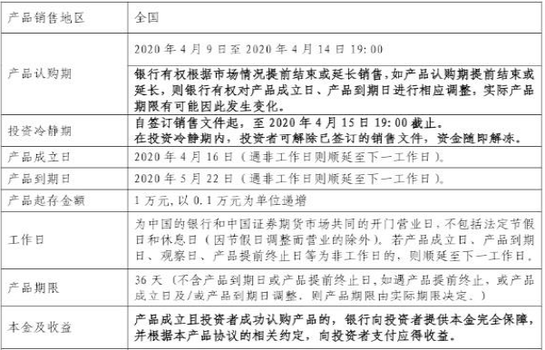
银行理财产品
中证500看涨36天

Slide 27
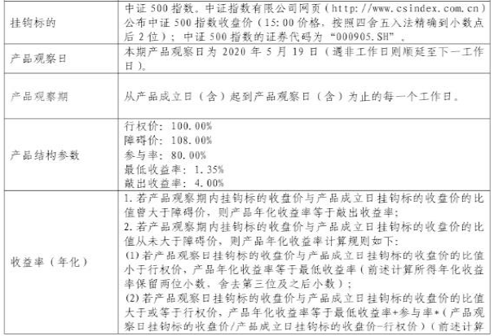
银行理财产品
中证500看涨36天

Slide 28
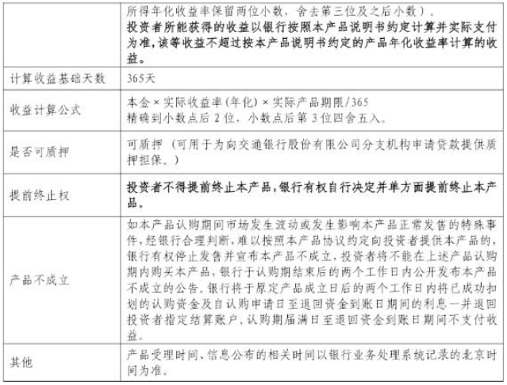
银行理财产品
中证500看涨36天

Slide 29
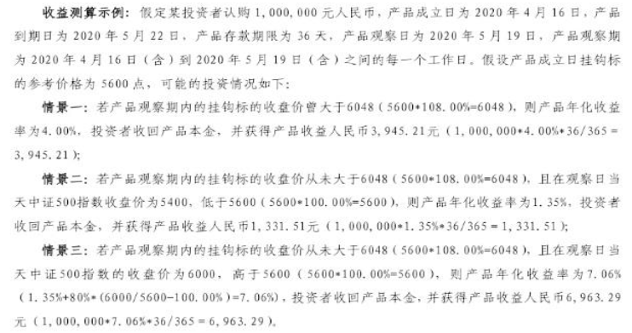
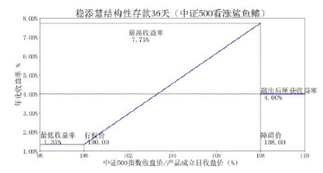
银行理财产品
中证500看涨36天

Slide 30
银行理财产品
中证500看涨36天

Slide 31
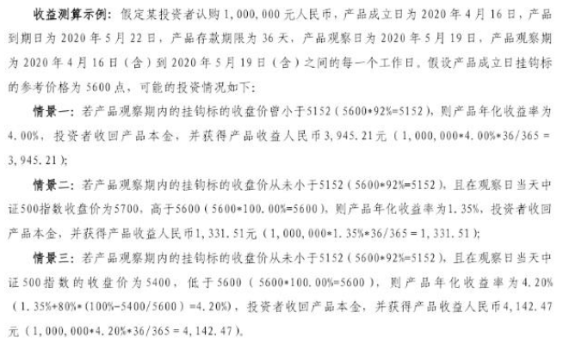
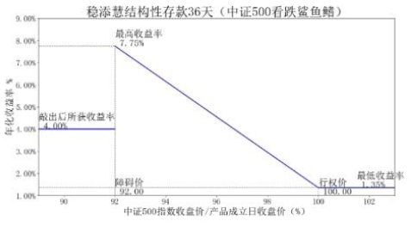
银行理财产品
中证500看跌36天

Slide 32
银行理财产品
中证500看跌36天

